Slide 1

2021 Budget Public Hearing
Special Town Meeting of the Electors
November 7, 2020

Slide 2
Agenda
BUDGET OVERVIEW
REVENUES
Taxes
Intergovernmental Revenue
Licenses & Permits
Fines, Forfeitures & Penalties
Public Charges for Services
Intergovernmental Charges for Services
Misc. Revenues
Proceeds to Long-Term Debt
EXPENDITURES
General Government
Public Safety
Public Works
Culture, Recreation and Education
Conservation & Development
Other Financing & Debt
Capital Outlay

Slide 3
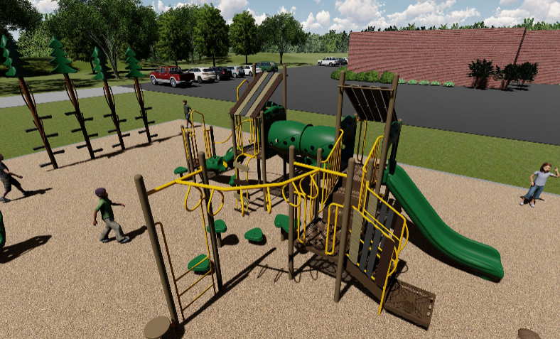

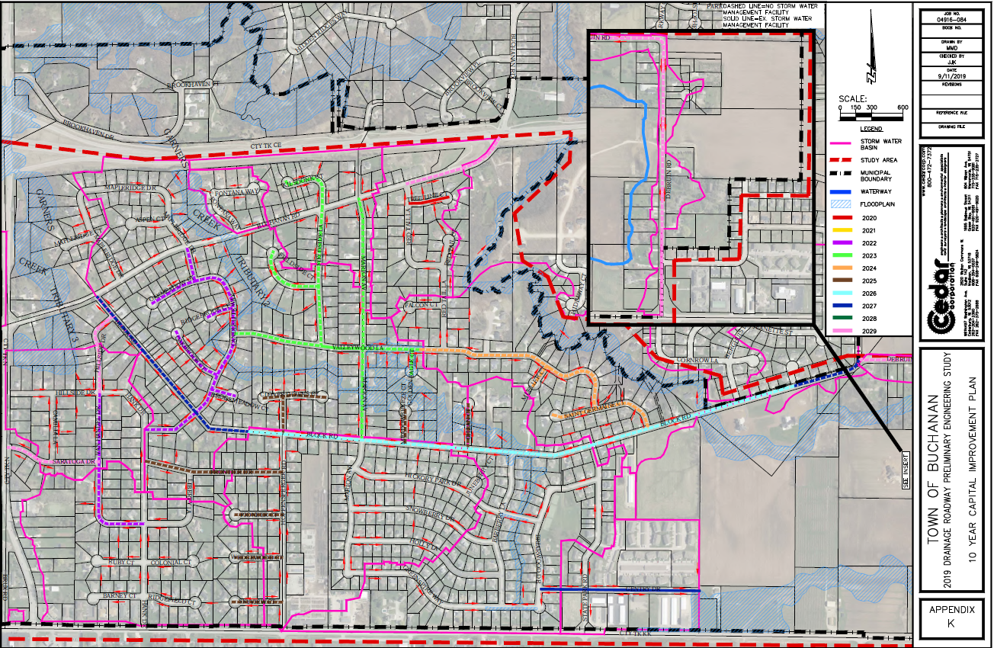
2020 Highlights
Completed Organizational Assessment and Employee Classification and Compensation Study
Completed Drainage and Roadway Preliminary Engineering Study
Established a 10 Year Transportation Improvement Plan
Signed an Intergovernmental Agreement to reconstruct CTH N and the roundabout while accepting a $3.5 million grant
Updated Budget and Financial Policies – Fund Balance and Investment
Replaced park equipment at Town Hall Park
Began a Fire Feasibility Study with surrounding communities
Promoting community identity with street sign installation
Continued to invest in maintaining Town Hall – lighting efficiency project & roof repairs

Slide 4
2021 Budget Timeline
Week of August 19: Town Administrator reviewed department budgets with directors
October 29:
  Town Board to review proposed budget and, potentially, finalize to be presented at November public hearing
November 7:
  Public Hearing where staff provides comprehensive presentation of proposed budget
  Town Electors establish compensation of elected Town officials to begin in April 2020
  Town Electors adopt the 2019 town tax levy to be paid in 2020
Next Steps
November 19:
  Town Board approved the 2020 Special Charge for garbage/recycling/yard waste collection and disposal
  Town Board approves Resolution adopting the 2020 Fiscal Year Budget

Slide 5
2021 Budget Approach
Long range planning to ensure resilience by focusing on key areas….
Financial stabilization and sustainability
Utility development
Infrastructure maintenance & repair
Organizational resilience
Expand the Tax Base
Revenue
Enhancements
Expenditure Restraint

Slide 6
2021 Proposed Budget Snapshot

Slide 7
2021 Budget – Levy Limits
Town is limited to actual growth based on “net new construction” or 0%
  Buchanan had 1.19% net new construction in 2019
Without an approved Referendum, Town is allowed to increase General Property Tax Levy to $1,451,765, an increase of $38,962 from prior year.
Notes:
The levy limits provide the maximum amount a municipality, the Town, can implement as a property tax levy within its boundaries. The Town is allowed to increase its levy by the percentage increase in net new construction.

Slide 8
2020 Property Tax Levy
Tax Levy Distribution:
General Property: $1,451,765*
Debt Service: $ 452,990 (Required)
Road Maintenance: $ 350,000
Total Levy: $2,254,755
* Allowable General Levy is amount listed
Other Taxes: $4,076
(Woodland/Forest, Penalties & Annexation Payments)
Notes:
The levy limits apply to the general fund. It does not apply to the debt service levy. The reason it does not apply is because ratings agencies like Moody’s would have downgraded every municipality in Wisconsin because they would not have had the ability to raise capital for future needs. The road maintenance levy is also not part of the levy limits. Taken together it does represent the local property tax levy. So, the amount in red is what will be allocated to each of the parcels in Buchanan based on their assessed value.
GF Increase is based on NNC and $19,833 one-time increase for Lowe’s, $500 one-time increase for taking ownership of the siren, $3,028 limited increase due to annexation and $338 increase to base for carryover

Slide 9
Town Budget Revenues
Taxes
Special Assessments
Intergovernmental Revenues
Licenses & Permits
Fines, Forfeitures & Penalties
Public Charges for Services
Misc. Revenue
Debt
Total 2020 Town Budget Revenues are $5,420,137.
53.22% ($1,882,731) increase from 2019.
89% ($1,670,000) of the increased capital investment in the Town’s infrastructure.
Notes:
Important to note this includes general, stormwater and transportation utility fund
Increase in total budget: 88.7% can be explained by…
Transportation Utility $1,000,000
Debt: $420,000
Special Assess: $250,000
Breakdown
Taxes - 41.7%
Special Assessments - 4.8%
Intergovernmental Revenues - 7.4%
Licenses & Permits - 1.8%
Fines, Forfeitures & Penalties - 0.2%
Public Charges for Services - 32.4%
Misc. Revenues - 2.8%
Debt - 8.9%

Slide 10
2021 Revenue Analysis

Slide 11
Town General Budget Expenditures
General Government
Public Safety
Public Works
Culture, Recreation & Education
Conservation & Development
Other Financing Uses
Total 2020 Town General Fund, including Other Financing Uses and Debt Service Expenditures, is $2,456,019.
0.8% ($19,510) increase from 2019.
Debt Service
Notes:
Breakdown
General Government - 20.0%
Public Safety - 24.1%
Public Works - 26.7%
Culture, Recreation & Education – 00.4%
Conservation & Development - 11.2
Other Financing Uses - 0.9%
Debt Service - 16.6%

Slide 12
GENERAL GOVERNMENT

Slide 13
General Government
This area of the budget includes:
Board
Legal Services
Election
Building Maintenance & Utilities
Insurance
Assessment Services
Audit Services
IT
Legislative
Legal Services Fee
General Administration
Financial Administration
General Building, Town Hall
Other General Government
Notes:
Total $554,608

Slide 14
General Government
Major Changes
Administrative Intern Position removed – (-$12,480)
Employee Insurance Rates have not been determined. Assumed to be 35% of employee pay, Engineering Tech included.
Payroll expenses increased due to creation of Engineering Tech position ($14,926)
Overall Increase in General Government - $43,576 (8.5%)
Total Cost of General Government Services - $554,608
Notes:
Administrative Intern position removed with the addition of an Engineering Tech. This was a .5 FTE at $12/hr for a total of $12,480.
Health and Dental Insurance for employees is approximately $71,000 (19% increase → 8.8% due to health care increase, rest due to position creation).
Payroll expenses increased $14,926 due to creation of Engineering Tech position.

Slide 15
Public Safety

Slide 16
Public Safety
This area of the budget includes:
Law Enforcement Services
Fire & Rescue
Emergency Management
EMS
Building Inspection
Law Enforcement Services
EMS
Fire & Rescue
Building Inspection
Emergency Management
Notes:
Total $648,945

Slide 17
Public Safety
Major Changes
Outagamie County Sheriff’s Contract decreased by 0.8%
Overall Increase in Public Safety - $421 (0.1%)
Total Cost of Public Safety - $648,945
Notes:
2010 the cost for law enforcement services was $100,000 more than 2020.

Slide 18
Public Works

Slide 19
Public Works
This area of the budget includes:
Roadway Maintenance
Winter Maintenance (Plowing)
Drainage Repairs
Valley Transit
Collection Services
Highway & Street Maintenance
Sanitation
Road Related Facilities
Mass Transit
Notes:
Total $729,337

Slide 20
Public Works
Major Changes
30% of Engineering Tech position allocation to Highway and Street Maintenance ($16,500)
Collection services cost increase of 5.7% ($20,977)
Overall Increase in Public Works - $8,753 (-1.2%)
Total Cost of Public Works Services - $729,337
Notes:
Carry over amount of $55,000 removed from Highway and Street Maintenance
New household rate is $150.91, which is a $8.67 (6.7%) increase
Reason for collection services increase
Cost/unit/month increased 1.3%
Labor rate for yard waste increased 36.8%
Tipping fee for garage increased $1.8/ton and for yard waste $2/ton

Slide 21
Culture, Recreation & Education

Slide 22
Culture, Recreation & Education
This area of the budget includes:
Parks
Recreation Events
Parks
Recreation Programs & Events
Notes:
Total $10,000

Slide 23
Culture, Recreation & Education (CRE)
Major Changes
No major changes
Overall Decrease in CRE - $1,500 (13.0%)
Total Cost of CRE Services - $10,000
Notes:
$1,500 was put in for Pickleball courts in 2019

Slide 24
Conservation & Development

Slide 25
Conservation & Development
This area of the budget includes:
Economic Development
Zoning
Stormwater Management
Economic Development
Planning & Zoning/Erosion/Conservation
Notes:
Total $35,140

Slide 26
Conservation & Development
Major Changes
Increase in erosion and drainage review expenses to cover cost of inspections ($19,917)
Overall Increase in Conservation & Development - $4,467 (14.6%)
Total Cost of CRE Services - $35,140

Slide 27
Other Financing Uses

Slide 28
Other Financing Uses
This area of the budget includes:
Contingency Funds
Reserve Funds
Fund Balances | Est. Year End 2019 Balance
Undesignated Fund Balance | $596,101
Contingency Fund | $177,340
Fire Reserve Fund | $75,744
Park Impact Fee Fund | $46,667
Building Improvement Fund | $57,147
Trail Development Fund | $50,066
Road Improvement Fund | $2,555
TOTAL | $1,005,620
Notes:
Total $30,673

Slide 29
Other Financing Uses
Major Changes
Allocate $75,000 of the Contingency Fund for one-time capital projects
Allocate $10,000 of the Building Improvement Fund to plan for acquired properties
Allocate $5,000 of Park Impact Fees for capital parks projects
Allocate $15,000 of the Trail Development Fund for planned trails
Contribution to the Building Improvement Fund of $10,000
Contribution to the Fire Reserve Fund of $15,000
Overall Net Effect to Other Financing Uses - - $77,000
Total Other Financing Uses - $329,519

Slide 30
Debt Service

Slide 31
Debt Service
Major Changes
No major change
Overall Increase in Debt Service - $0 (0.0%)
Total Debt Service - $452,990

Slide 32
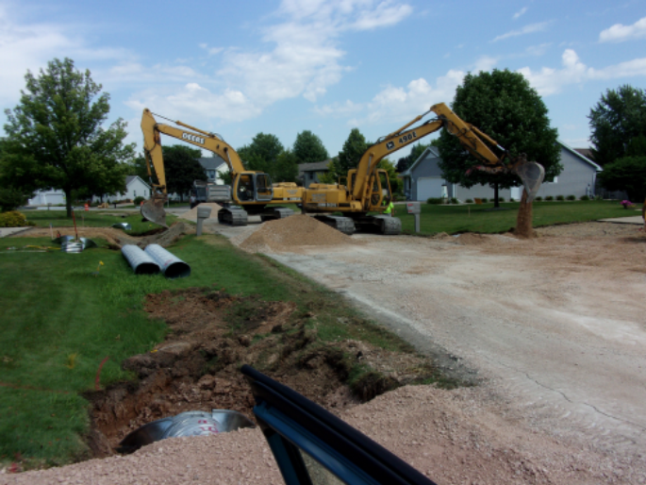
Capital Outlay
General Government, Parks, Fire & Rescue, Roads & Public Works Projects

Slide 33
Capital Outlay
Project Categories
Project Categories for 2020 Projects
The Town projects are broken into four areas for a total of $2,509,760 in projects.
General Government
Roads & Public Works
Parks
Fire & Rescue
Notes:
For 2020, there are 18 projects that will cost a total of $2,509,760.

Slide 34
General Government
2020 Projects
GG
AV Equipment for Town Board Room and Conference Room - $39,892
Replace Town Hall Sign - $35,000
Strategic Plan - $25,000
Financial System Software Upgrade - $20,000
Citizen Survey - $14,000
Property Planning Expenses - $10,000
Computer Replacement - $ 7,500
Total Cost of General Government Projects - $151,392

Slide 35
Parks
2021 Projects
P
Springfield Park
Drainage Study $ 5,800
Tree Planting Program - $ 5,000
Trails with Signage - $ 10,000
Total Cost of General Government Projects - $20,800

Slide 36
Fire & Rescue
2021 Projects
FR
Mezzanine - $7,500
Specialized Equipment Trailer - $8,000
Total Cost of Fire & Rescue Projects - $15,500

Slide 37
Roads & Public Works
2021 Projects
RPW
Eastowne Court/Emons Road (Eisenhower Drive to Pinecrest Boulevard - $437,875
Treeline Court - $ 88,800
Speel School Road, Milky Way - $1,214,220
Kebe Court - $230,100
Harvard Court/Cornell Court - $201,072
Hickory Park Trail (Block Road to CTH KK) $150,000
Total Cost of Road & Public Works Projects - $2,322,067

Slide 38
Capital Outlay
Project Funding Sources
Project Funding Sources for 2021 Capital Outlay
For 2020, there are nine sources that generate $2,693,000.
Transportation Aids
Road Maintenance Levy
Misc. Revenue
Debt
Special Assessment
Property Tax Levy
Stormwater Utility
Transportation Utility
GF Revenue
Notes:
There is approximately $143,133 (would have been $183,133, but $30,000, or 40% allocation, of Engineering Tech position is expended, along with $10,000 for GIS) remaining from funding sources dedicated to the transportation network.

Slide 39
2020 Proposed Budget
Revenues
Expenditures

Slide 40
Town Tax Rate History
2010-2019

Slide 41
Town Tax Rate Components
2015-2019

Slide 42
2020 Town of Buchanan Real Estate Taxes on a Average Valued Home in Kimberly SD
(GROSS TAXES NOTE REDUCED BY GENERAL, FIRST DOLLAR & LOTTERY CREDIT)
Total Tax Bill
$4,035 OR
$335.25/Month
Notes:
Average valued home in Buchanan is $227,700.
For every dollar of property taxes paid, Buchanan is directly paid 18¢.

Slide 43
Monthly Property Taxes for Town Services
(BASED ON AN AVEAGE ASSESSED SINGLE FAMILY RESIDENTIAL PROPERTY VALUE OF $227,700)
Notes:
$724.08 a year in Town taxes, which is about $31.88 less than this year.

Slide 44
Next Steps
November 19:
  Town Board approved the 2021 Special Charge for garbage/recycling/yard waste collection and disposal
  Town Board approves Resolution adopting the 2021 Fiscal Year Budget
Thank you
Questions and Comments.

